Slide 1

Exploring Containerization for Protecting Unmanned Robotic Vehicles
Chidera Okoro
cjokoro@shockers.wichita.edu
Hasan Monowar
monowar.hasan@wichita.edu

Slide 2
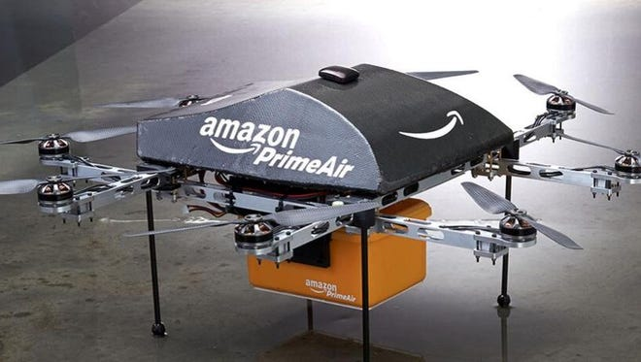
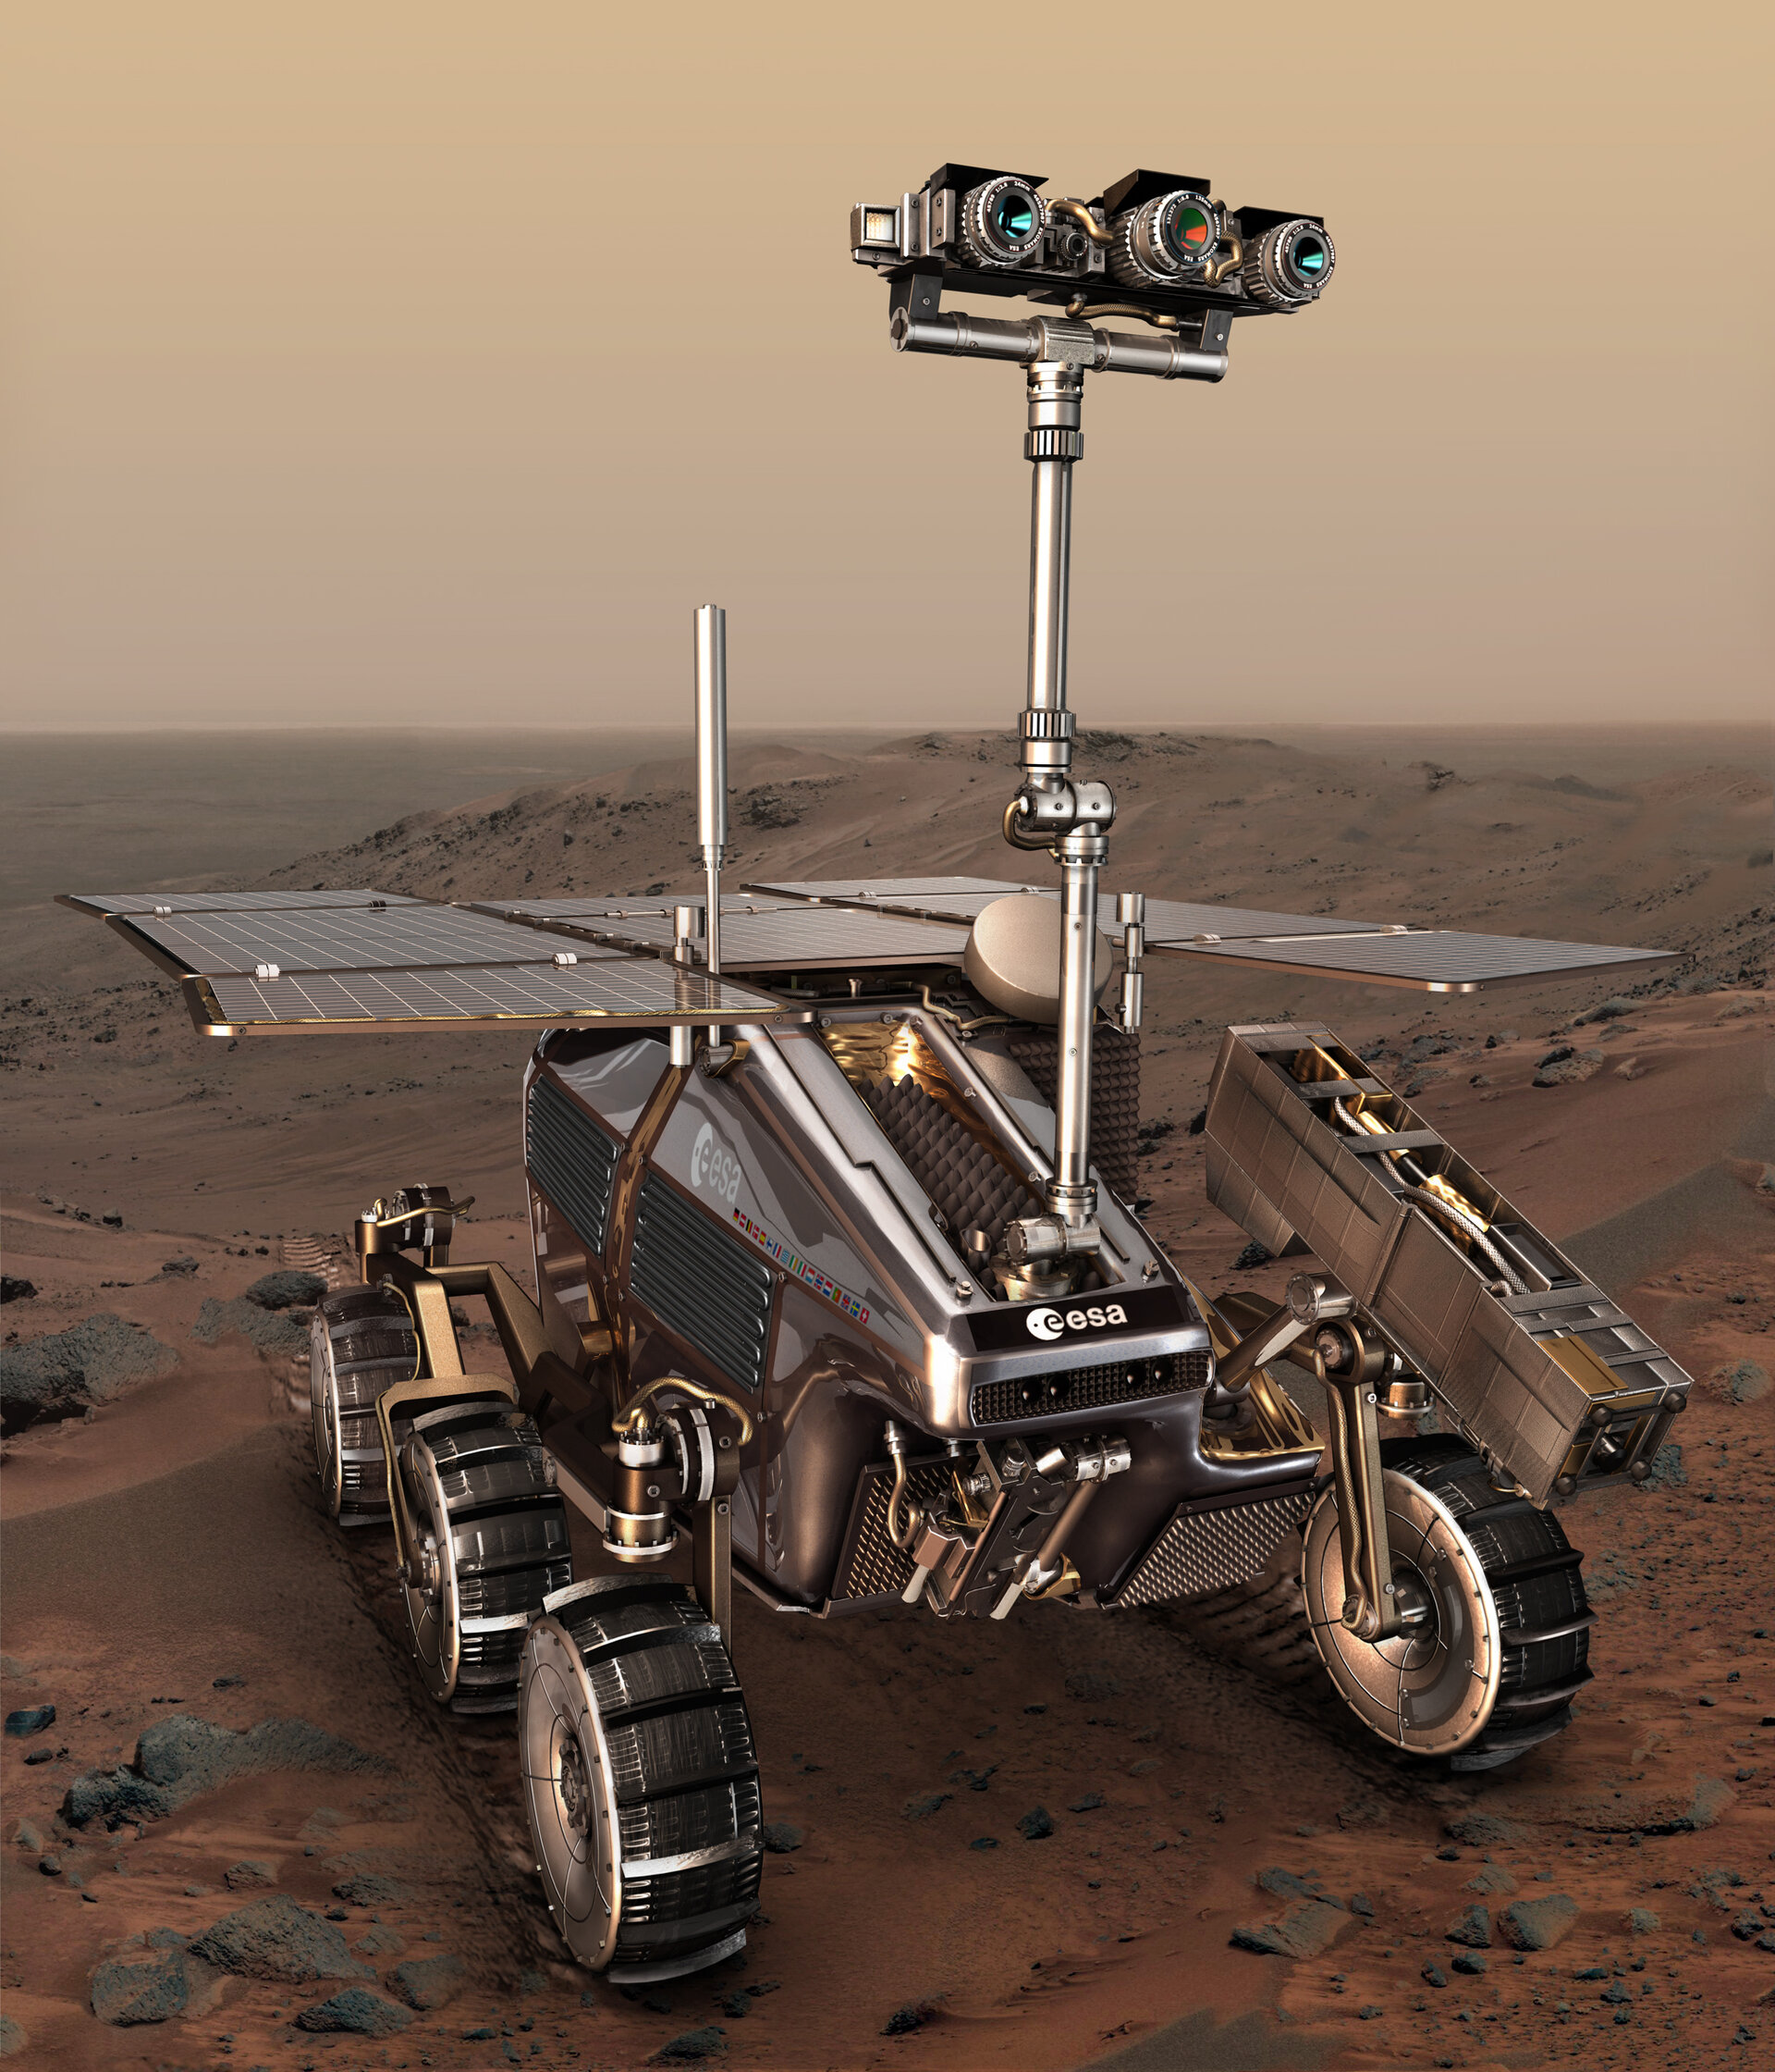
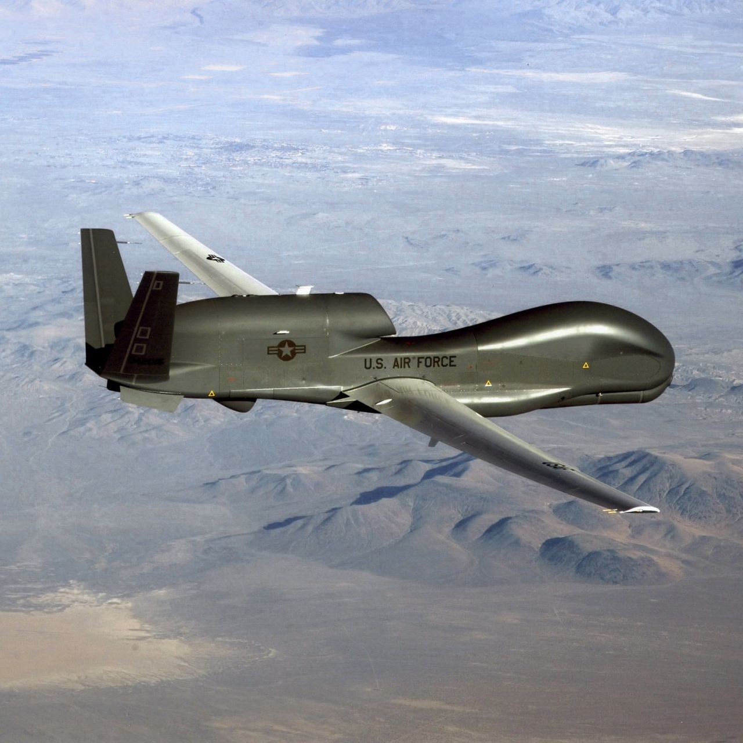
Robotic Vehicles (RVs)
Applications
Surveillance
Communication
Delivery
Agriculture
Manufacturing

Slide 3
RV Security?
Traditional robotic vehicles:
Custom hardware
Closed-source software
Not interconnected
Modern robotic vehicles:
Off-the-shelf (COTS) components
Open-source software
More interconnected → Internet
Larger attack surface!

Slide 4


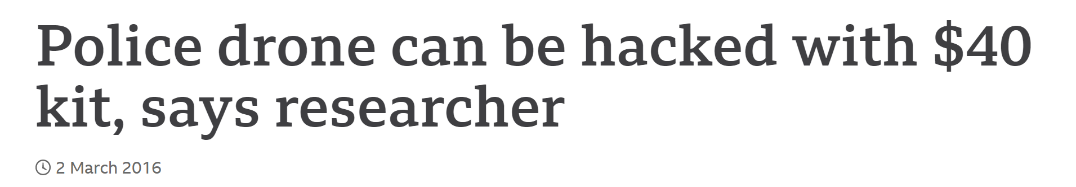
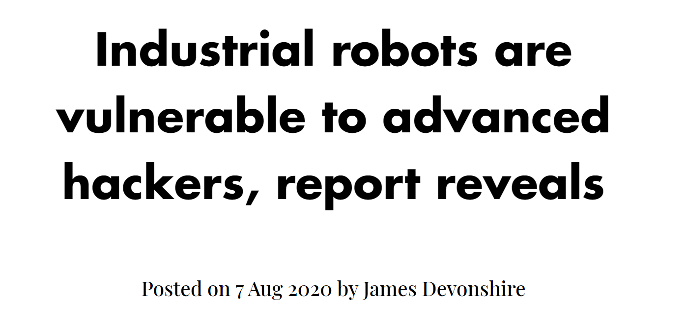

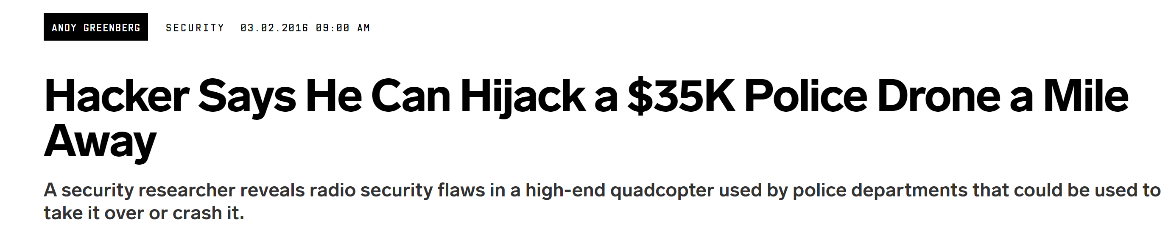
RV Security?

Slide 5


Vanilla Robotic Systems
RV Application
RV malfunction
No way to control what goes in and out of application
System may crash
Fatalities among humans
Destruction to surrounding environment
malicious attack
Operating System
Can we do better?

Slide 6

Adversary Model
Attack Model
RV Application
RV application can be compromised
No specific assumptions on how the attacker compromise
bugs, vulnerabilities, social engineering, remote update
OS is trusted
Hardware attacks are not considered
Operating System
RV Hardware

Slide 7
Our Approach Sandboxing RV Applications
Containerization
Container
RV Application
Container
RV Application
Container
RV Application
Container
RV Application
Isolates surrounding environment (sandboxing)
Limits resources
RV application runs inside the container
Operating system communicates with containers
Operating System

Slide 8


Containerization of RV Applications
RV Application
Monitors the behavior of the application
Able to see what goes in and out of application
We can enforce design time configurations
Container
malicious attack
Operating System
Configuration Manager

Slide 9

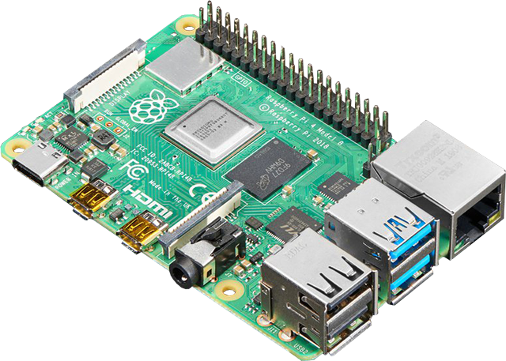
Containerization of RV Applications
Linux Container (LXD)
Control groups
responsible for managing resource usage
RV Application
Namespaces
provides isolation of system resources
Operating System
Container Runtime
Configuration Manager
Ethernet
network interface that is bridged to OS network
Hardware

Slide 10
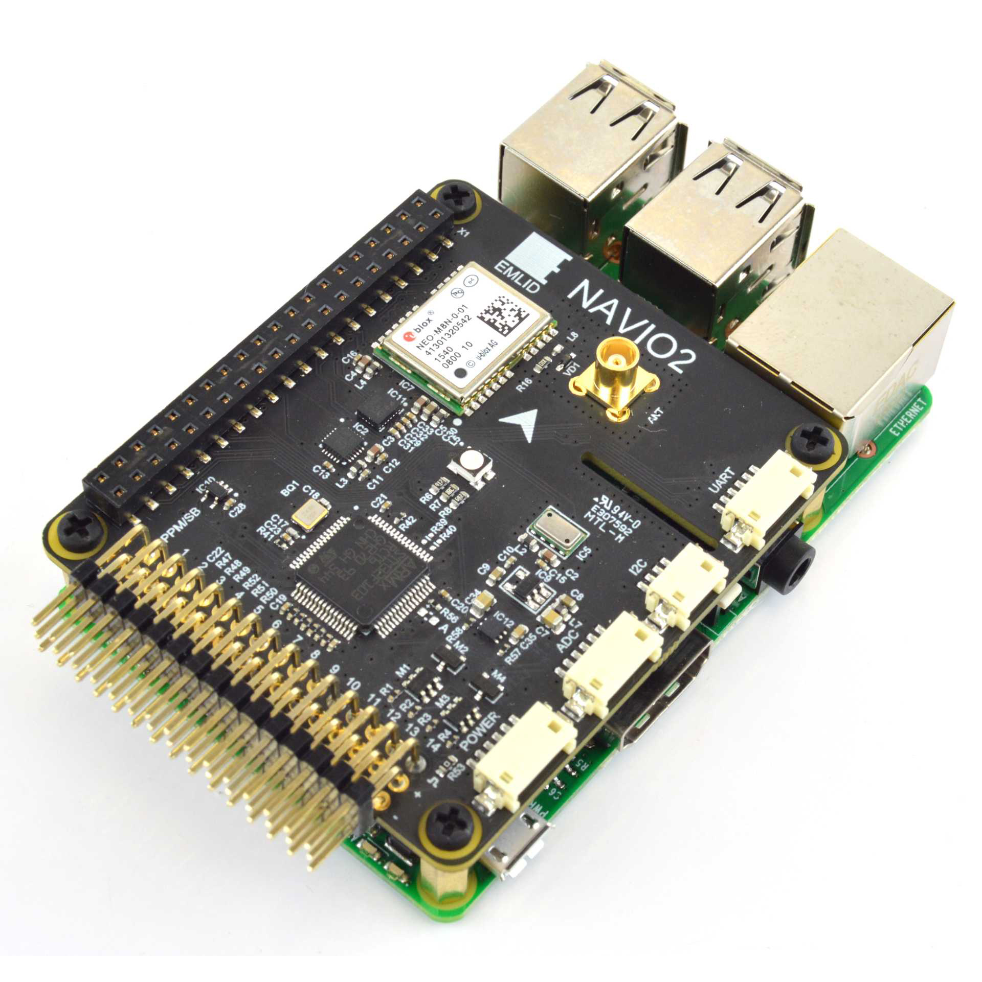


Experiment Setup
Hardware
Raspberry Pi 3 Model B
Navio2 extension board
Software
Ardupilot Software Version 3
Linux Container – LXD 4.0
Implementation publicly available:
https://github.com/CPS2RL/rv_security_container.git

Slide 11

Experiments
Security Analysis and Overhead Analysis
Denial of Service
Performance Overhead
System call
- Implementing an attack that inserts a denied system call into a program
Performance in Execution Time
- Took over 10,000 data points to calculate the mean, standard deviation, 99th percentile, and ECDF
Memory Exhaustion
- Implementing an attack that overcomes the allowed threshold for memory storage
malicious attack
Performance in Memory Usage
- Took over 10,000 data points to calculate the mean, standard deviation, 99th percentile, and ECDF

Slide 12
Results

Slide 13
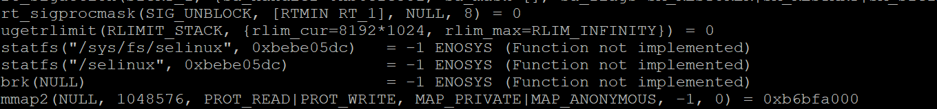
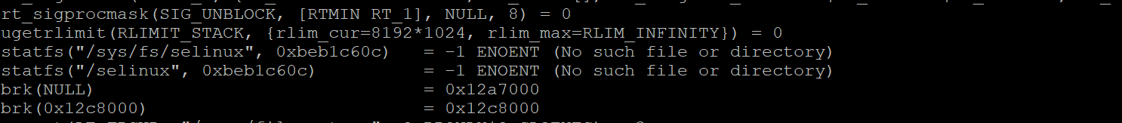
Security Analysis: System Call Access
Denial of Service
if(GPS.init(){
GPS.setSensor(1);
}
else{
GPS.setSensor(0);
}
brk();
The brk() function is disabled from being accessed by the container.
When an unauthorized system call is implemented into the program, it results in the change of the execution flow.
The brk() function is being called and used in our approach.

Slide 14
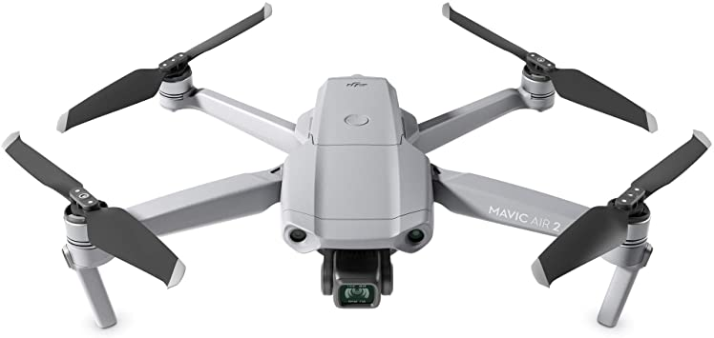
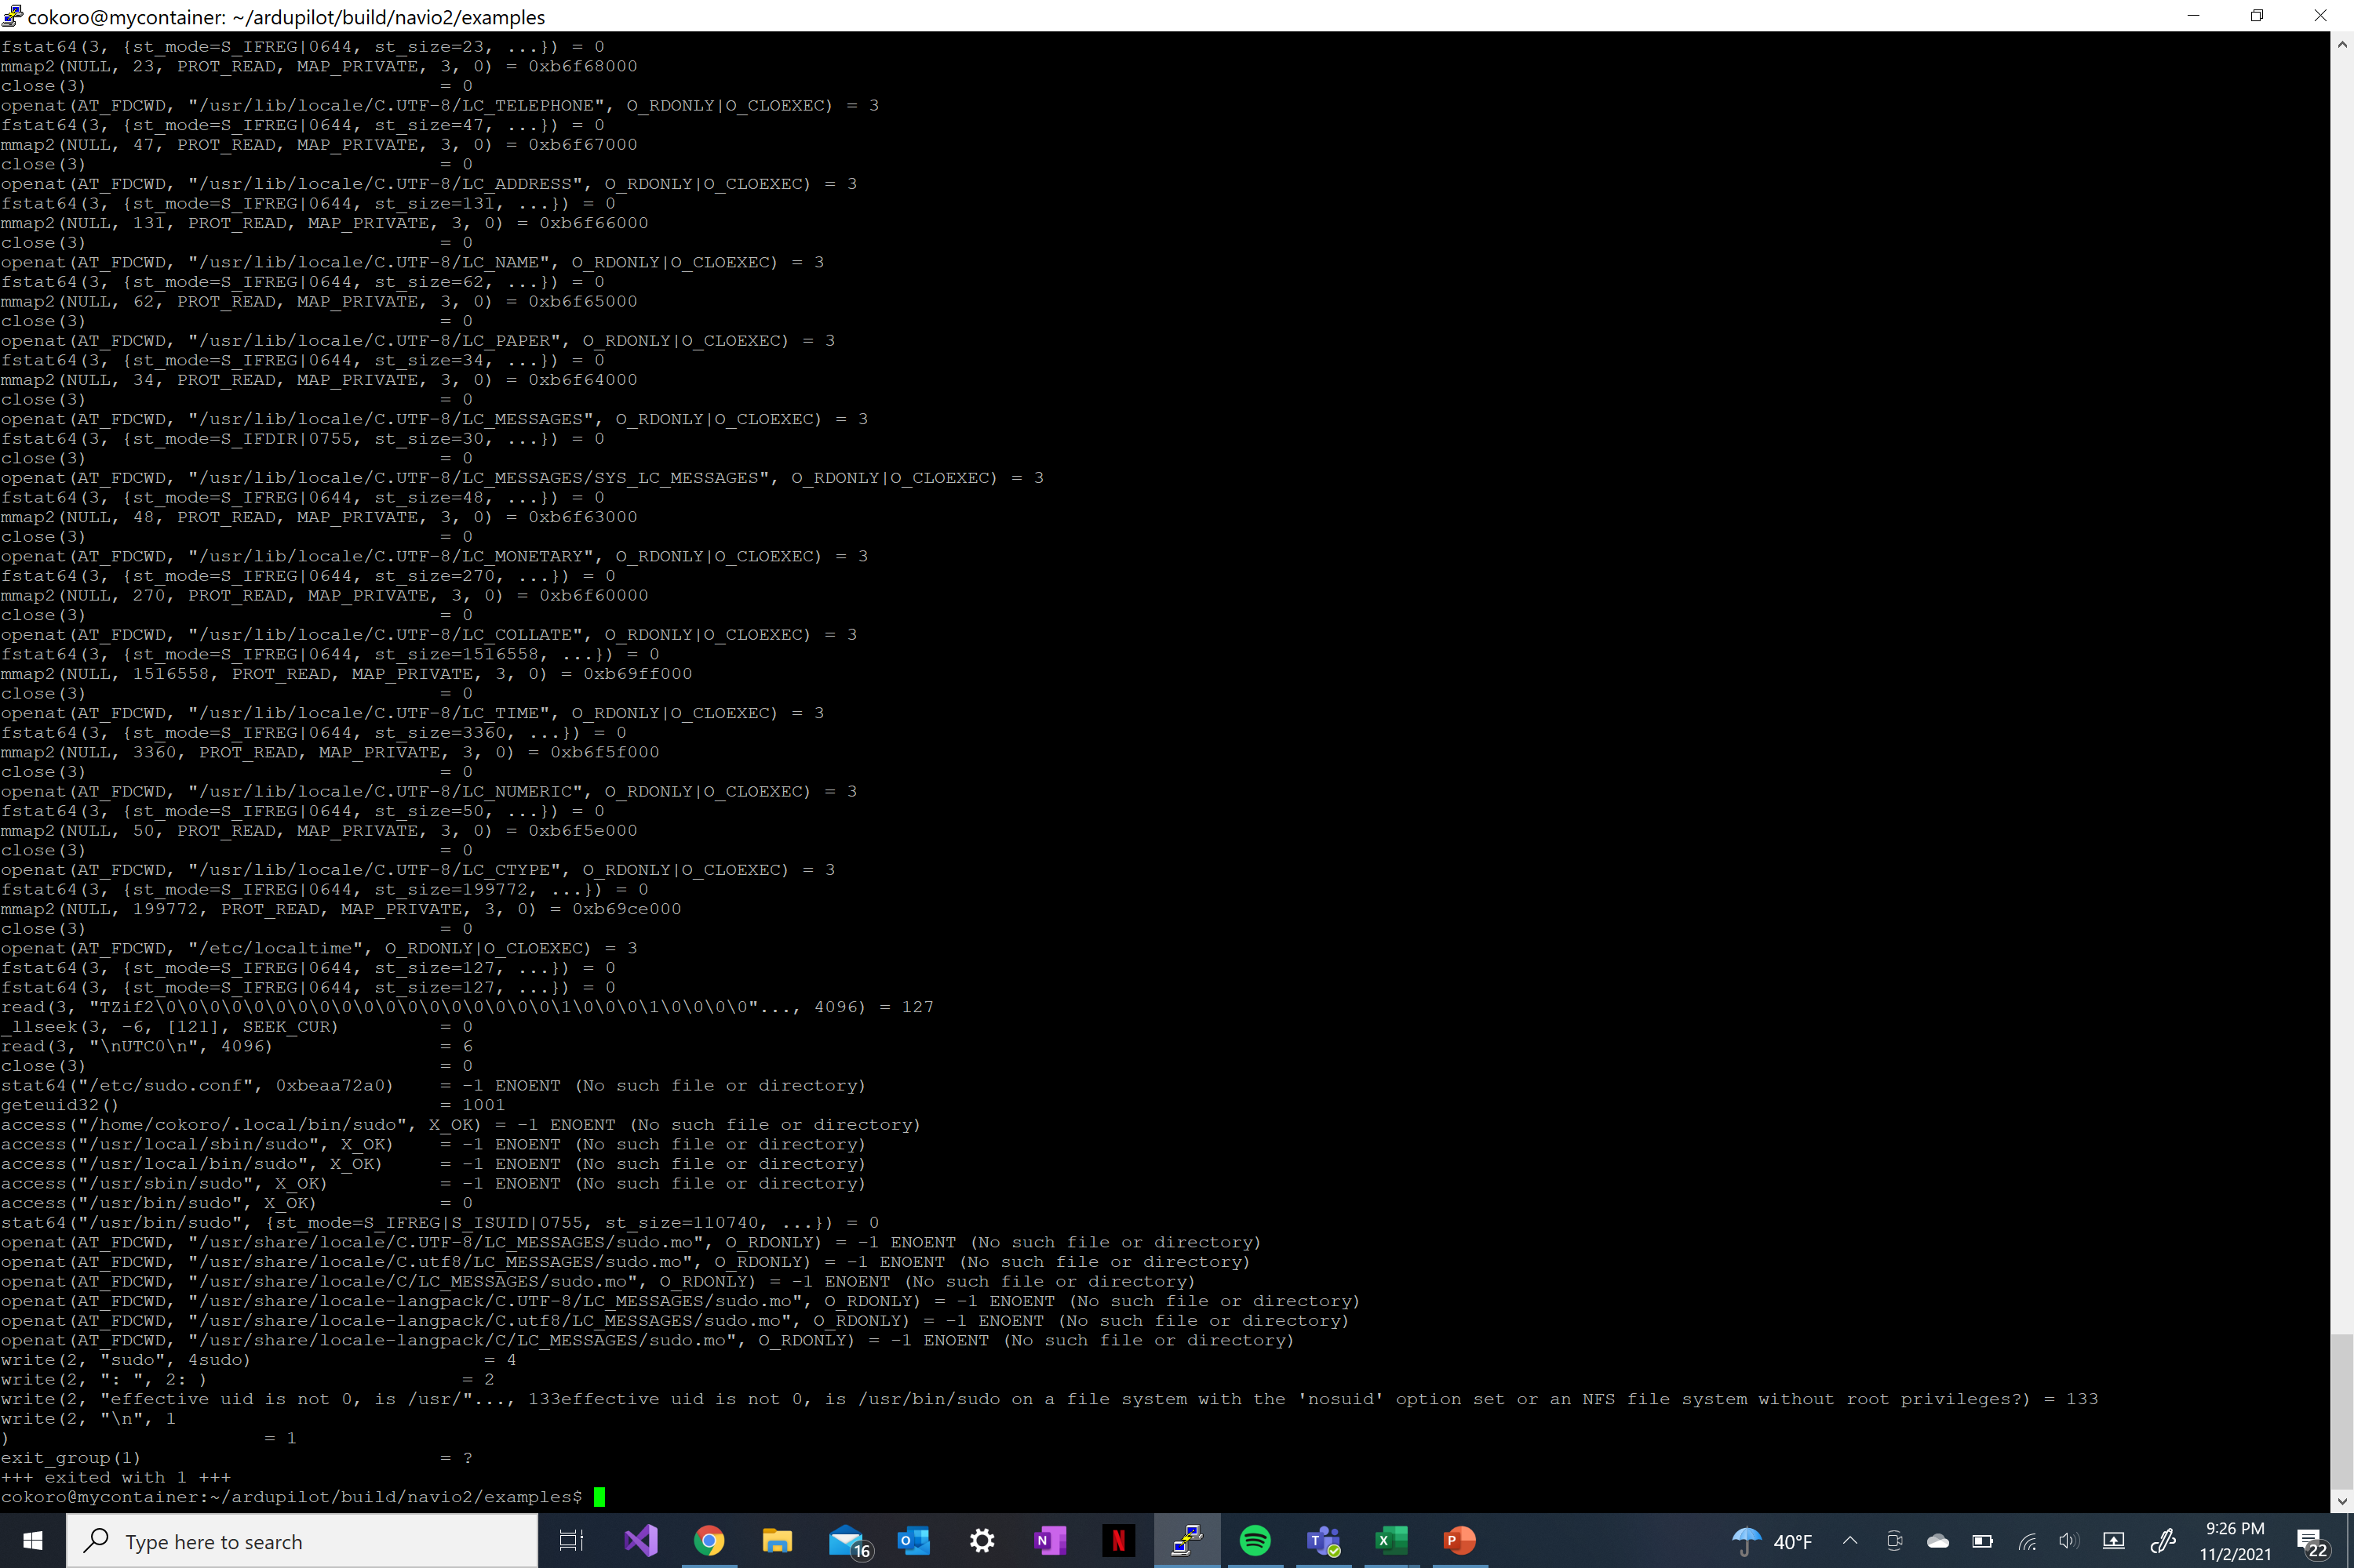
Security Analysis: System Call Access Experiment Two
An attacker can write to a file that changes the implementation of the propeller
Writing to root-authorized file can cause the ardupilot software to not perform correctly

Slide 15
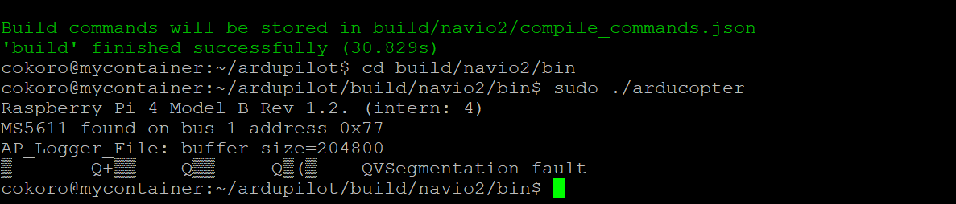
Security Analysis: Memory Exhaustion
Memory Exhaustion
Percentage of Memory Usage
Our Approach
With the use of containerization, the configuration manager can detect the memory leak and prevent the software from a segmentation fault.
Execution Time in Seconds
Our Approach
Vanilla

Slide 16
Overhead Analysis Impact on Execution Time
Empirical Distribution Graph of Ardupilot Barometer Application
 | Execution Time (microseconds)
 | Vanilla | Our Approach
Mean | 29.133 | 31.186
STD. Deviation | 8.868 | 10.673
99th Percentile | 68.206 | 76.023
ECDF
Execution Time in Microseconds
The overhead of our approach was minimal with only a 1.07x increase in application execution time
Summary:
Our Approach
Vanilla

Slide 17
Overhead Analysis Impact on Memory Usage
Empirical Distribution Graph of Ardupilot Barometer Memory Usage
ECDF
 | Execution Time (kilobytes)
 | Vanilla | Our Approach
Mean | 67.302 | 98.522
STD. Deviation | 55.906 | 90.538
99th Percentile | 252 | 252
The overhead of our approach was minimal with only a 1.46x increase in application execution time
Kilobytes Used
Summary:
Our Approach
Vanilla

Slide 18
Conclusion
Our research shows the feasibility of using containers for RV applications
Containerization of RV Applications
Allows to monitor the behavior of the RV application without significant overheads
Can enforce design time configurations and prevent unauthorized access
Our future research:
Will explore attacks on other signals (such as I/O, network, and timing anomalies).
Will also evaluate other autopilot software (e.g., Paparazzi and PX4).

Slide 19
Thank You!
Questions?

